Slide 1
SMD Soldering Workshop
By Arti & Liz

Slide 3
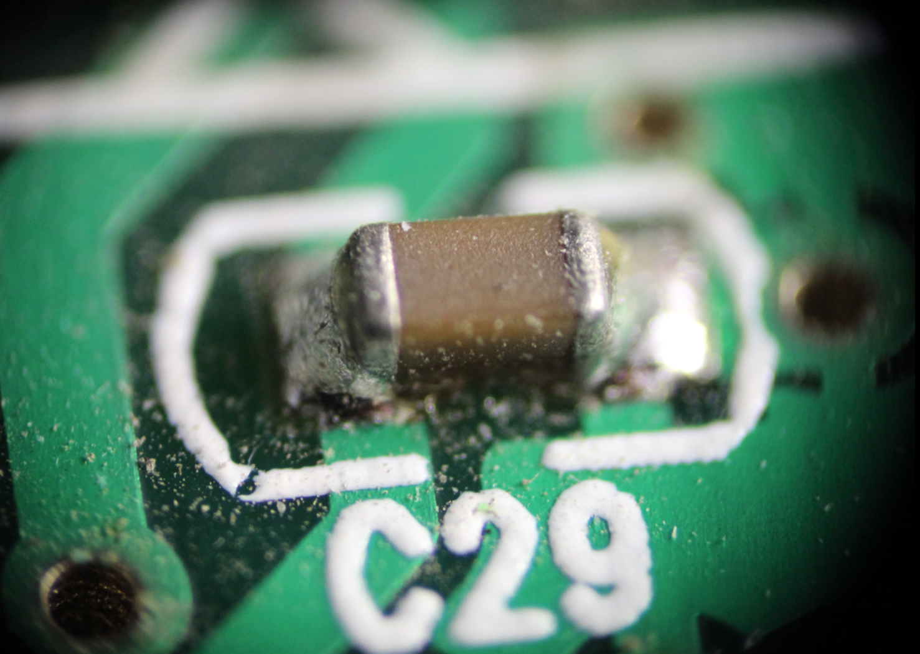
Surface Mount Device
Circuit components that are directly mounted onto the surface of PCBS

Slide 4
Through-hole vs. Surface Mount
Through-hole mounting
provides stronger mechanical bonding
Requires drilling holes on PCBs → limits the available routing area
Surface Mounting
Much smaller components → denser, smaller PCBs
Can be mounted on both sides of the board

Slide 5
Important Steps
Tin one metal pad first
Place the component with tweezers
Solder one side of the component on the tinned pad
Solder the other side

Slide 6
https://youtu.be/OaOaRaGGdMc?t=1507

Slide 7
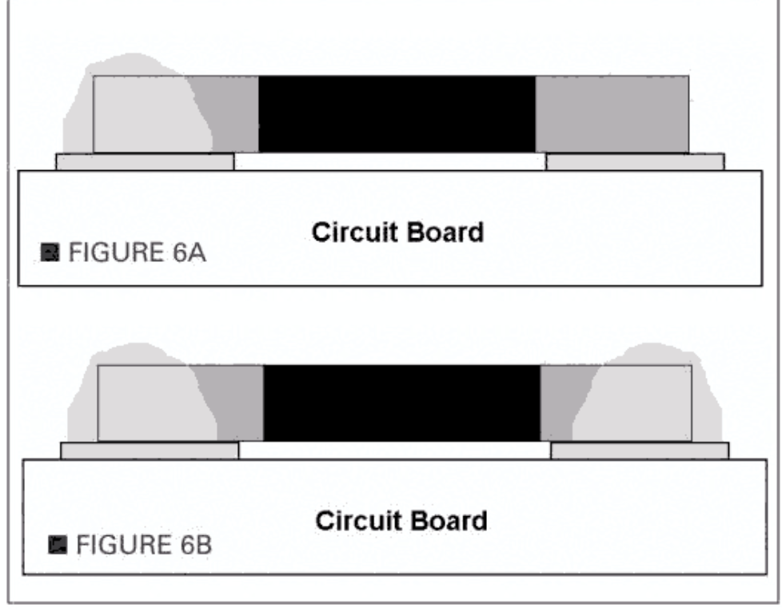
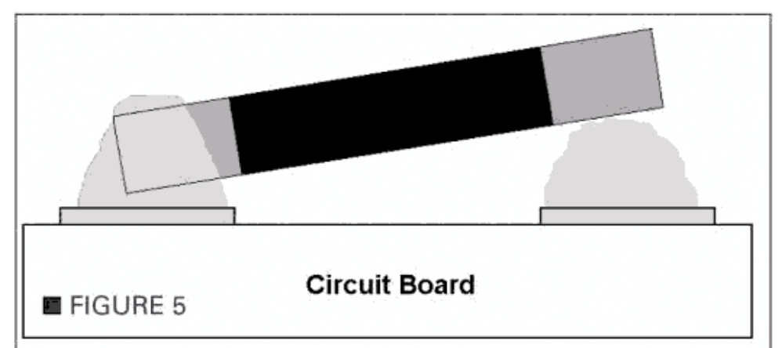
Be Careful!
WRONG
CORRECT!

Slide 8
Now for the real fun...

Slide 9
Components!
PCB x 1
555 timer x 1
10k resistor x 2
510 resistor x 1
0.01 uF cap x 1
10 uF cap x 1
Diode x 1
Female battery holder x 1
Male battery holder x 1

Slide 10
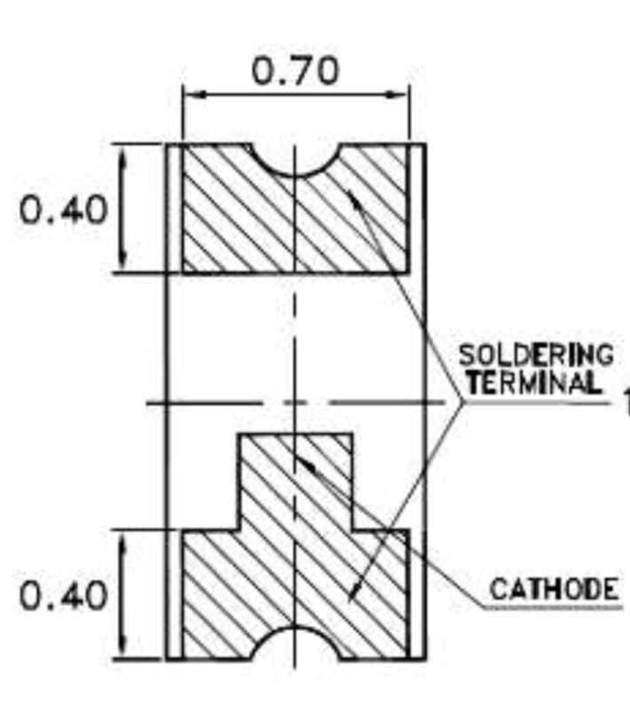
Diode
Make sure you get diode’s orientation right!
Cathode should be the side that’s closer to C2
Notes:
Diode datasheet: https://www.digikey.com/product-detail/en/lite-on-inc/LTST-C191KRKT/160-1447-1-ND/386836

Slide 11
Notes:
R1, R2=10K
R3=510
C1=0.01uF
C2=10uF

